Slide 1



Fundamentals

Slide 2
Learning Objectives
Operations Security (OPSEC) is essential to protecting the success of The Navy, your command, mission and the lives of service members, Navy employees, contractors and family.
Upon completion of this course, you will be able to:
Define OPSEC
Explain and employ the OPSEC Cycle
Explain how OPSEC is implemented in Day-to-Day Activities

Slide 3

DUSN (I&S) Message on OPSEC

Slide 4
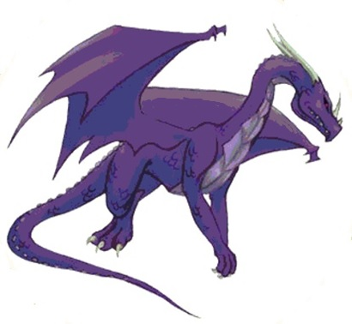
OPSEC
Section 1

Slide 5
OPSEC is…
Per NTTP 3-13.3:
  A capability that identifies and controls critical information and indicators of friendly force actions attendant to military operations, and reduces the risk adversaries can exploit friendly force vulnerabilities by incorporating countermeasures.
  Best incorporated at the start of an operation or mission planning not added on as an afterthought.

Slide 6
OPSEC is…
A dynamic process and can change as the mission and environment change.
An information-related capability (IRC) that, can be used to gain advantages in the information environment (IE), just as other military techniques are used in the operational environment (OE).
An operations function. Security, intelligence, counterintelligence (CI) and other functions and capabilities support its implementation.
Everyone's responsibility.
A Force Multiplier

Slide 7
OPSEC is…
Required by:
  National Security Presidential Memorandum (NSPM) – January 2021
  DoDD 5205.02E / Change 2 – August 2020
  SECNAVINST 3070.2 (Series)
  Your Immediate Superior In Charge (ISIC) / Higher Head Quarters (HHQ)
  Your Command

Slide 8
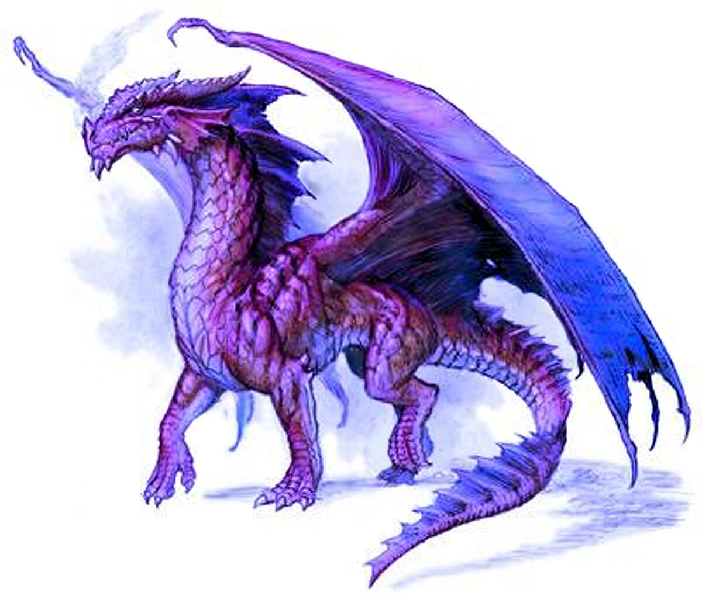
Summary
OPSEC is
  A capability
  Best incorporated at the start of an operation or mission
  A dynamic process
  An IRC
  An operations function
  Everyone's responsibility
Required by:
  National Security Presidential Memorandum (NSPM) – January 2021
  DoDD 5205.02E / Change 2 – August 2020
  SECNAVINST 3070.2 (Series)

Slide 9
The OPSEC Cycle
Section 2

Slide 10
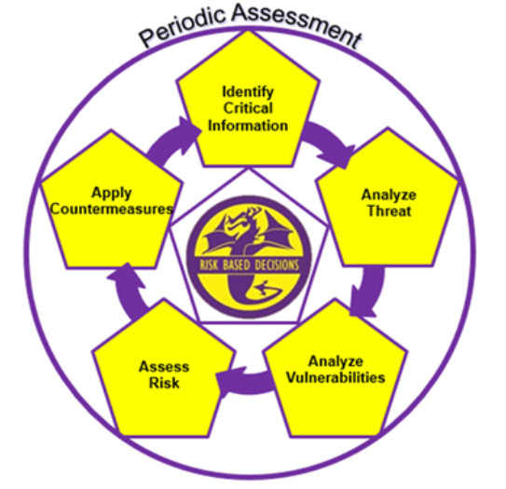
The OPSEC Cycle
The enabling vehicle for OPSEC analysis and employment, allowing for the integration and mutual support of all traditional security disciplines such as
  Physical
  Information
  Cyber
  Personnel
  Technical
  Links to other IRCs such as
    Public Affairs (PA)
    Military Deception (MILDEC)
    Military Information Support Operations (MISO)
    Etc

Slide 11
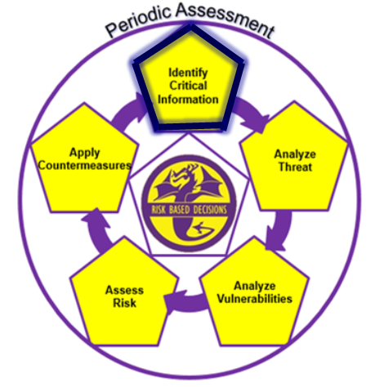
Identify Critical Information
Starts with identifying mission essential operational aspects (essential secrets) that apply to your command
  Presence - Where your unit is currently located
  Capability - The unique abilities that your unit lends to
  the operation
  Strength - The number of units or personnel coupled with the ability to withstand great force
  Intent - What your unit plans to do
  Readiness - Level of preparedness to execute
  Timing - Specific timelines of events
  Location - Where your unit will deploy to
  Method - The way the mission will be executed
  Information supporting applicable essential secrets shall be considered critical information.

Slide 12
Identify Critical Information
Critical information is unclassified information about friendly activities, that the adversary seeks to use against us.
  Such information, if revealed to the adversary, may prevent or complicate mission accomplishment, reduce mission effectiveness, damage friendly force resources, or cause loss of life.
  Indicators are friendly detectable actions and open-source information that can be interpreted or pieced together to allow the adversary to obtain critical information or to identify friendly force vulnerabilities.
    Indicator Characteristics
      Signatures are characteristics of indicators that makes them identifiable or cause them to stand out.
      Associations are relationships of indicators to other information or activities.
      Profiles of activity are the summation of all signatures and associations.
      Contrasts are the changes and deviations from a standard profile.
      Exposure of an indicator is a characteristic that refers to when and how long an indicator is observable.

Slide 13

Critical Information Examples
New technology improving the command defensive posture, not already disclosed in Publicly Available Information (PAI) domain.
Supports Essential Secret –
Capability
43% of the crew inflicted by biological contaminant.
Supports Essential Secret –
Readiness & Strength
Amphibious Assault Rehearsal (situation dependent).
  Supports Essential Secret –
  Intent

Slide 14
Usually Not Critical Information
For the majority of command missions/operations:
  If the information you are considering “critical” does not support any of the essential secrets, then it is usually not critical information and is not added to the command critical information list (CIL).
Examples
  Personally Identifiable Information (PII) – Protected via the PII program and Privacy act
  Protected Heath Information (PHI) – Protected via the Health Insurance Portability and Accountability Act (HIPPA)
  All Controlled Unclassified Information (CUI) – Protected via the CUI program consistent with applicable laws, regulations and government wide policies. (www.dodcui.mil)
    OPSEC is a category of CUI (all critical information is CUI, not all CUI is critical information)
  Classified information – Protected via the DoD Information Security Program

Slide 15
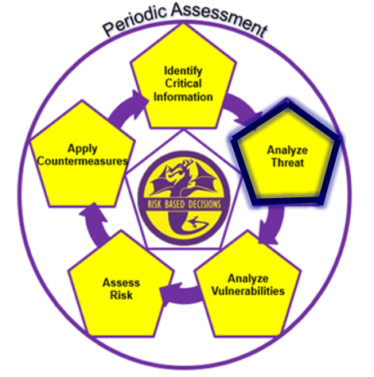
Analyze Threat
Our most capable adversaries are highly motivated and intent on collecting information about our military operations, all the time
  Always protect against the Foreign Intelligence Entities (FIEs)
    “Be Ready! Don’t Get Ready.”
Understand collection methods used by our adversaries
  Open Source Intelligence (OSINT)
  Signals Intelligence (SIGINT)
  Human Intelligence (HUMINT)
  Geospatial Intelligence (GEOINT)
  Measurement and Signature Intelligence (MASINT)
  Ubiquities Technical Surveillance (UTS)
Understand adversary proficiency regarding collection methods

Slide 16
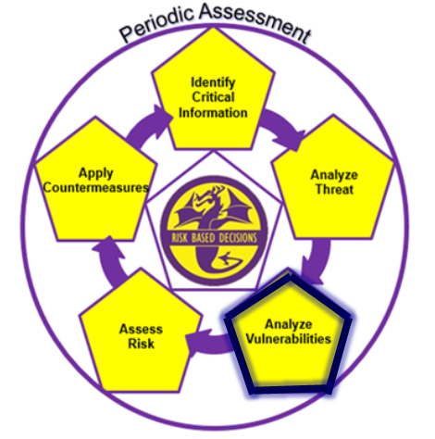
Analyze Vulnerabilities
Examining friendly operations or activities – seeking ways that the adversary might determine critical information in time to disrupt or defeat an operation or activity.
Common Vulnerabilities:
  Lack of awareness or apathy regarding:
    Command critical information
    Adversary information collection capabilities
    Elicitation
    Protecting unclassified really not worth the effort
  Unsecure communications involving critical information
  Social media (official vs personal use)
  Commercial applications
  Trash
  Technology

Slide 17
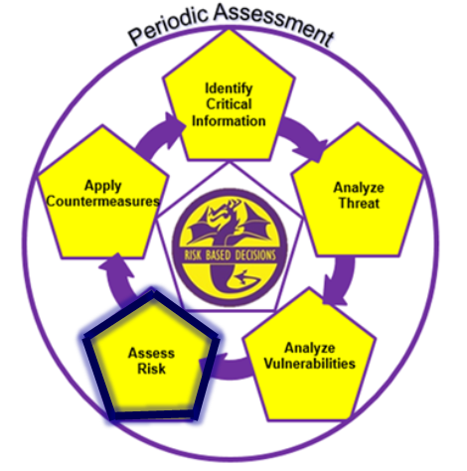
Assess Risk
Estimating the adversary’s capability to exploit a vulnerability & gain access to critical information, and the potential effects that could have on an operation.
RISK = THREAT (capability) x IMPACT (critical information value)
Example
  Critical information (CI) rated HIGH
  CI exposed on social media
  The adversary’s OSINT capability (threat) is rated HIGH
  (Risk = Threat x Impact); the Risk is HIGH.
  Impact can be measured in loss of time, money, and LIVES
The Commander determines the acceptable level of risk.

Slide 18
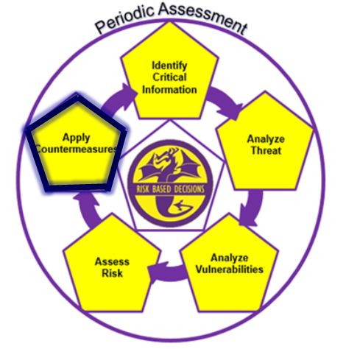
Apply Countermeasures
OPSEC countermeasures mitigate vulnerabilities in order to protect critical information from adversarial exploitation.
Implemented to reduce risk to levels acceptable by the Commander.
Considerations:
  Cost (time, money, resources)
  Benefit (Is the juice worth the squeeze?)
  Affect on mission/operation
    Does it slow processes and/or procedures to unacceptable levels?
    Does it create new vulnerabilities?

Slide 19
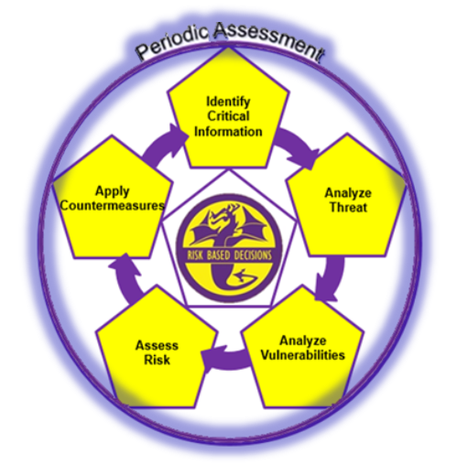
Periodic Assessment
The OPSEC cycle is a continuous process. It should never be considered a ‘one and done’ requirement.
The operational and information environments are constantly evolving, requiring commands to assess their OPSEC postures continuously to maintain essential secrecy.
OPSEC is perpetual

Slide 20
Summary
The OPSEC Cycle
  Identify Critical Information
  Analyze Threat
  Analyze Vulnerabilities
  Assess Risk
  Apply Countermeasures
  Periodic Assessment

Slide 21
Day-to-Day OPSEC
Section 3

Slide 22

OPSEC
General Rules
Rule 1:
  OPSEC is proactive, NOT reactive
Rule 2:
  OPSEC is an art, NOT a science
Rule 3:
  OPSEC is everybody’s responsibility

Slide 23
Command’s OPSEC Role
Appoint an OPSEC Officer
Appoint OPSEC Working Group (OWG) members
  OWG members shall include representatives from all major command components, departments, or functions
OWG
  Applies the OPSEC cycle in day-to-day operations
  Makes recommendations for revisions to the CIL and implementation of OPSEC countermeasures
Develop command-specific OPSEC training
  Provided to all assigned personnel during check-in, at least annually, and whenever needed
Conduct OPSEC review on all public releasable information
Conduct periodic self-assessments to determine OPSEC program effectiveness

Slide 24
Personnel’s OPSEC Role
Reducing Operational Risk by mitigating Vulnerabilities through Countermeasures
  Follow existing OPSEC and other security policies at the command.
    If something doesn't look right, inform a supervisor.
  Encrypt emails
    Assume unencrypted email and conversations in the open are compromised.
  Do not use commercial apps or email to transmit operational information, regardless of advertised encryption or security.
  When underway, do not use personal wireless (cellular) devices without express authorization from the chain of command.
  Keep critical information off social media, including messaging platforms.
  When teleworking, strictly follow telework policy and procedures.
  Properly destroy and dispose of trash.

Slide 25

Personnel’s OPSEC Role
When pieced together, unclassified information can become sensitive or even classified.
  Move the conversation/email to SIPR when needed.
If you are not familiar with the organization’s critical information list (CIL), take time to seek it out and get smart!

Slide 26
Summary
General Rules
  OPSEC is proactive, NOT reactive
  OPSEC is an art, NOT a science
  OPSEC is everybody’s responsibility
Command’s OPSEC Role
Personnel’s OPSEC Role

Slide 27
Final Test
Section 4

Slide 28
Test Question
OPSEC is (Select all that apply):
  A capability
  An administrative function
  A program
  An information-related capability (IRC)
ANSWER: A & C

Slide 29
Test Question
The Department of the Navy’s primary OPSEC instruction is:
  MCO 3070.2
  OPNAVINST 3432.1 (Series)
  NSPM-28
  SECNAVINST 3070.2 (Series)
ANSWER: D

Slide 30
Test Question
From the list provided identify the essential secrets
(Select all that apply):
A. Intent
B. Timing
C. Logistics
D. Method
E. Technology
F. Location
G. Tactics, Techniques, and Procedures (TTP)
ANSWER: A, B, D & F

Slide 31
Test Question
4. True/False: Critical information supports applicable command essential secrets.
A. True
B. False
ANSWER: A

Slide 32
Test Question
5. True/False: If not identified properly, indicators can allow the adversary to obtain critical information or to identify friendly force vulnerabilities.
A. True
B. False
ANSWER: A

Slide 33
Test Question
6. From the list provided, what would be considered critical information? (Select all that apply):
  New defensive technology at the command
  PO3 Mishka’s Social Security number
  75% of command personnel scheduled to receive Anthrax vaccination by specific date
  Base security incident report involving domestic assault
ANSWER: A & C

Slide 34
Test Question
Our most capable adversaries are highly motivated and capable of collecting our information using which collection methods?
(Select all that apply):
A. OSINT
B. UTS
C. WEPINT
D. SIGINT
E. GEOINT
F. UAPINT
G. HUMINT
H. MASINT
ANSWER: A, B, D, E, G & H

Slide 35
Test Question
8. Analyze Vulnerabilities is:
Examining a friendly operation or activity, seeking ways the adversary might determine critical information
Identifying weaknesses in our defenses which would allow adversary combat superiority
Examining adversary operations or activities, seeking ways to best employ our collection methods to determine their essential secrets
None of the above
ANSWER: A

Slide 36
Test Question
9. Risk is determined by:
A. Critical Information (x) Vulnerability
B. Threat (x) Countermeasure
C. Vulnerability (x) Impact
D. Threat (x) Impact
ANSWER: D

Slide 37
Test Question
10. OPSEC countermeasures mitigate ___________ in order to protect ____________.
A. Impact; Risk
B. Risk; Vulnerabilities
C. Vulnerabilities; Critical Information
D. None of the above
ANSWER: C

Slide 38


Name

